Slide 1
Dt282 Operating Systems 2
Deadlock and Starvation

Slide 2
Introduction
Resource sharing perspectives
Memory management and processor sharing
Many programs competing for limited resources
Lack of process synchronization consequences
Deadlock: “deadly embrace,” “Catch 22,” “blue screen of death,” etc.
Two or more jobs placed in HOLD state
Jobs waiting for unavailable vital resource
System comes to standstill
Unresolved by OS: requires external intervention

Slide 3
Deadlock, Livelock, and Starvation
Deadlock:
Two processes are unable to proceed because each is waiting for the other to “do” something.
Livelock:
Two or more processes continually change their state without doing any useful work (e.g. disk sharing )
Starvation:
One of the processes is continually rolled back or selected as victim for recovery from deadlock

Slide 4
Deadlock
More serious than starvation
Affects entire system
Affects more than one job
All system resources become unavailable
More prevalent in interactive systems
Real-time systems
Deadlocks quickly become critical situations
OS must prevent or resolve deadlock

Slide 5
Cases of Deadlock
Non-sharable/non-preemptable resources
Files, printers or scanners
Allocated to jobs requiring same type of resources (sharable resources like database and disks…)
Resource types locked by competing jobs
File requests
Databases
Multiple device allocation
Spooling
Disk sharing

Slide 6
The race problem
Race (lost update problem) between processes
Results when locking not used and no concurrency enforcement policy
Causes incorrect final version of data
Depends on process execution order
Prevented by using concurrency locking (refer to lecture mutexs: test-set, wait and signal and semaphores)

Slide 7
Example 1: Lost Updates
Transactions
User X: Updating Customer A account with withdrawal of $50
User Y: Updating Customer A account with deposit of $25
Customers balance should be (100 –50 + 25 = 75)
USER X USER Y
1 Read Cust A record (Balance = $100) 1 Read Cust A record (Balance = $100)
2 Bal = Bal - 50 (Balance = $50) 2 Bal = Bal + 25 (Balance = $125)
3 Write Cust A record (Balance = $50) 3 Write Cust A record (Balance = $125)
Time

Slide 8
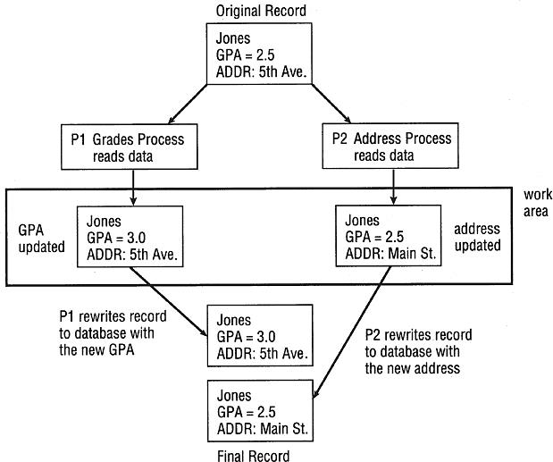
Example 2: the race problem in databases
(figure 5.3)
Case 2. P1 finishes first and wins the race but its version of the record will soon be overwritten by P2. Regardless of which
process wins the race, the final version of the data will be incorrect. © Cengage Learning 2014

Slide 9
A way of modeling Deadlocks
Directed graphs: Richard Holt (1972)
Circles represent processes
Squares represent resources
Line with arrow from resource to process
Process holding resource
Line with arrow from a process to resource
Process waiting for resource
Arrow direction indicates flow
Cycle in graph
Deadlock involving processes and resources

Slide 10
Case 1: Deadlocks on File Requests
Jobs request and hold files for execution duration
Example (Figure 5.2)
Two programs (P1, P2) and two files (F1, F2)
Deadlock sequence
P1 has access to F1 and also requires F2
P2 has access to F2 and also requires F1
Deadlock remains until:
One program is closed or
One program is forcibly removed and file is released
Other programs requiring F1 or F2
Put on hold for duration of situation

Slide 11
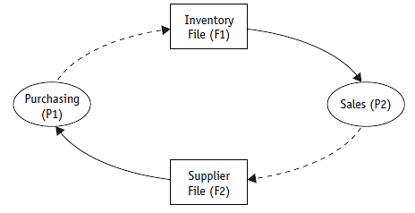
Case 1: Deadlocks on File Requests (cont'd.)
(figure 5.2)
Case 1. These two processes, shown as circles, are each waiting for a resource, shown as rectangles, that has already been allocated to the other process, thus creating a deadlock. © Cengage Learning 2014

Slide 12
Necessary Conditions for Deadlock or Livelock
Four conditions required for a locked system
Mutual exclusion: allowing only one process access to dedicated resource
Resource holding and waiting: may hold a resource (not releasing the resource); while waiting assignment of another resource, held by another job (for other job to retreat)
No pre-emption: no resource can be forcibly removed from a process holding it
Circular wait: each process waiting for another to voluntarily release so at least one can continue
All conditions required for deadlock
Resolving deadlock: remove one of the conditions

Slide 13
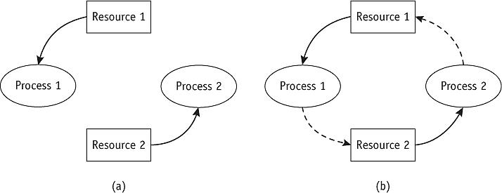
Modeling Deadlocks (cont'd.)
(figure 5.7)
In (a), Resource 1 is being held by Process 1 and Resource 2 is held by Process 2 in a system that is not deadlocked.
In (b), Process 1 requests Resource 2 but doesn’t release Resource 1, and Process 2 does the same— creating a deadlock. (If one process released its resource, the deadlock would be resolved.) © Cengage Learning 2014

Slide 14
Modeling Deadlocks (cont'd.)
In the following examples there are:
System has three processes (P1, P2, P3)
System has three resources (R1, R2, R3)
Three graph scenarios to help detect deadlocks
Scenario one: no deadlock
Resources released before next process request
Scenario two: deadlock
Processes waiting for resource held by another
Scenario three: no deadlock
Resources released before deadlock

Slide 15
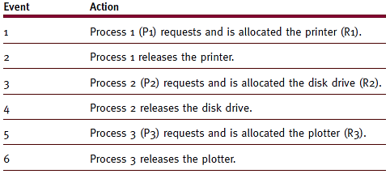
Modeling Deadlocks (cont'd.)
No deadlock
Resources released before next process request
(table 5.1)
Scenario 1. These events are shown in the directed graph in Figure 5.8. © Cengage Learning 2014

Slide 16
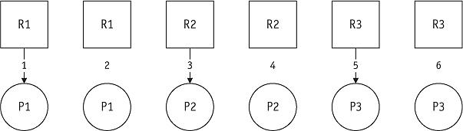
Modeling Deadlocks (cont'd.)
No deadlock
Resources released before next process request
(figure 5.8)
First scenario. The system will stay free of deadlocks if each resource is released before it is requested by the next process. © Cengage Learning 2014

Slide 17
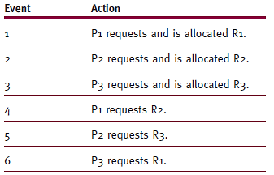
Modeling Deadlocks (cont'd.)
Deadlock
Processes waiting for resource held by another
(table 5.2)
Scenario 2. This sequence of events is shown in the two directed graphs shown in Figure 5.9. © Cengage Learning 2014
In Event 4-6 each request is blocked (possibly leading to deadlock)

Slide 18
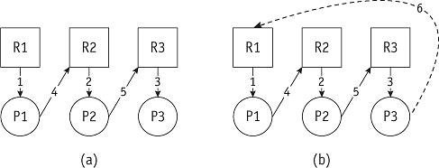
Modeling Deadlocks (cont'd.)
(figure 5.9)
Second scenario. The system (a) becomes deadlocked (b) when P3 requests R1. as represented by the circular wait shown here by dashed line from P3 to R1. In this case all the 4 conditions for deadlock are fulfilled. © Cengage Learning 2014

Slide 19
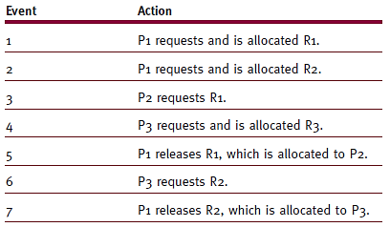
Modeling Deadlocks (cont'd.)
No deadlock
Resources released before deadlock
(table 5.3)
Scenario 3. This sequence of events is shown in the directed graph in Figure 5.10. © Cengage Learning 2014

Slide 20
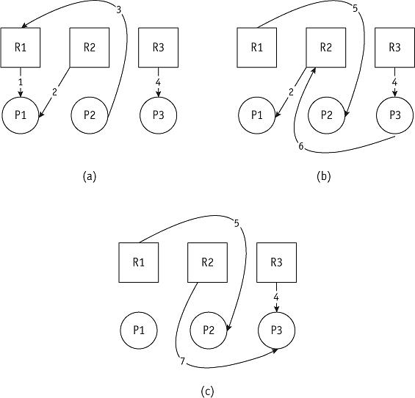
Modeling Deadlocks (cont'd.)
(figure 5.10)
The third scenario. After event 4, the directed graph looks like
(a) and P2 is blocked because P1 is holding on to R1. However, event 5 breaks the deadlock and the graph soon looks like (b). Again there is a blocked process, P3, which must wait for the release of R2 in event 7 when the graph looks like (c).
Refer to table 5.3 for 1…7

Slide 21
Three Strategies for Handling Deadlocks
Prevention
Prevent occurrence of one condition
Mutual exclusion, resource holding and waiting, no pre-emption, circular wait
Avoidance
Avoid deadlock if it becomes “probable”
Detection and Recovery
Detect deadlock when it occurs
Resume system normally, quickly and gracefully

Slide 22
Deadlock Prevention
Prevention eliminates any of the four conditions
Mutual exclusion
Some resources must be allocate exclusively so can not always be prevented.
However some resources, mutual exclusion, can be bypassed if I/O device uses spooling (may cause spooling deadlock)
Resource holding
Bypassed if jobs request every necessary resource at creation time; e.g. batch systems in advance given all required memory. (no memory resource deadlock)
However, the degree of Multiprogramming (memory allocation) decrease significantly and have Idle peripheral devices that are allocated to jobs (that may not use them all the time)

Slide 23
Deadlock Prevention
Prevention (cont'd.)
No preemption
Bypassed if operating system allowed to deallocate resources from jobs
Okay if job state easily saved and restored (round robin algorithm or page swapping)
Pre-empting dedicated I/O device or files during modification requires recovery tasks: undo/redo…
Circular wait
Requires jobs to anticipate resource request order of resources
One approach the resources must be requested using specific ordering schemes (printer = 1, disk =2…
So if the actual resource order was disk and printer it is still required to request printer first even thought it is will be used later…
Difficult to satisfy all users

Slide 24
Deadlock: Avoidance
Avoidance: checks if the “new” state is safe or unsafe
System knows ahead of time
Sequence of requests associated with each active process
Dijkstra’s Bankers Algorithm (Dijkstra, 1965)
Regulates resource allocation to avoid deadlocks
No customer granted loan exceeding bank’s total capital
All customers given maximum credit limit
No customer allowed to borrow over limit
Sum of all loans will not exceed bank’s total capital

Slide 25
Deadlock: Avoidance
Operating systems deadlock avoidance assurances
Never satisfy request if job state moves from safe to unsafe
Begin by Identify job with smallest number of remaining resources to complete the job
Number of available resources >= number needed for selected job to complete: safe state
A job is block whose request is jeopardizing safe state or unsafe state
Repeat this process for the remaining jobs if it is in a safe state.

Slide 26
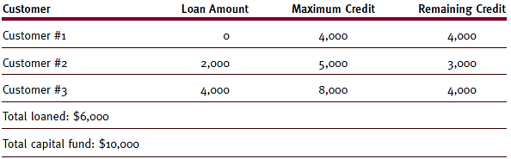
Strategies for Handling Deadlocks (cont'd.)
(table 5.4)
The bank started with $10,000 and has remaining capital of $4,000 after these loans. Therefore, it’s in a “safe state.” © Cengage Learning 2014

Slide 27
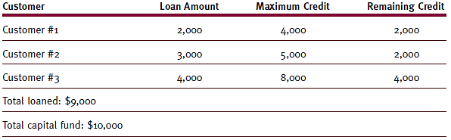
Strategies for Handling Deadlocks (cont'd.)
(table 5.5)
The bank only has remaining capital of $1,000 after these loans and therefore is in an “unsafe state.” © Cengage Learning 2014

Slide 28
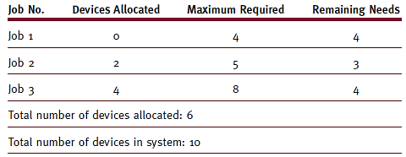
Deadlock: Avoidance (safe state)
(table 5.6)
Resource assignments after initial allocations. This is a safe state: Six devices are allocated and four units are still available. Note: this is only showing one resource. © Cengage Learning 2014

Slide 29
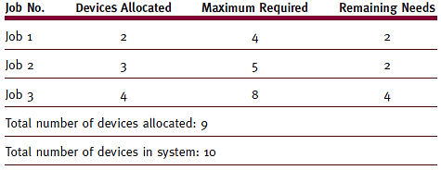
Deadlock: Avoidance (unsafe state)
(table 5.7)
Resource assignments after later allocations. This is an unsafe state: Only one unit is available but every job requires at least two to complete its execution. © Cengage Learning 2014

Slide 30
Deadlock: Avoidance
Problems with the Banker’s Algorithm
Jobs must state maximum number needed resources
Requires constant number of total resources for each class (problem is a resource breaks)
Possible high overhead cost incurred
Resources not well utilized
Algorithm assumes worst case
Scheduling suffers
Result of poor utilization
Jobs kept waiting for resource allocation

Slide 31
Deadlocks: Detection and Recovery
Detection: build directed resource graphs
Look for, potential, cycles
Algorithm detecting circularity
Executed whenever appropriate; at specific times or system performance deteriorates
Detection algorithm and steps in reducing them
Remove process using current resource and not waiting for one fig 11.b P3
Remove process that have all resource requests allocated ; e.g. P2 in fig 11.c
Go back to step 1
Repeat steps 1 and 2 until all connecting lines removed

Slide 32
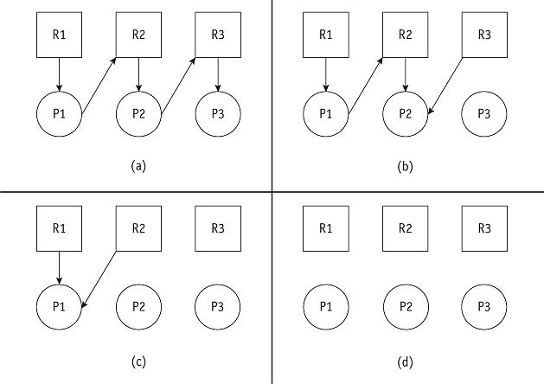
Detection and Recovery: Graph Reduction
(figure 5.11)
This system is deadlock-free because the graph can be completely reduced, as shown in (d). © Cengage Learning 2014

Slide 33
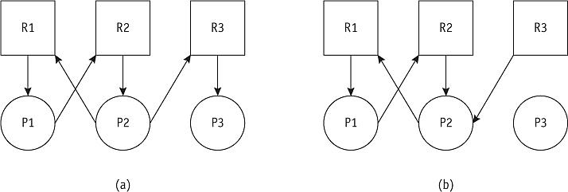
Detection and Recovery: Graph Reduction
Example of deadlock detection:
Even after this graph is reduced as much as possible (by removing the request from P3), a -> b
it is still deadlocked as b can not be reduced any further © Cengage Learning 2014

Slide 34
Deadlock: Detection and Recovery
Recovery
Deadlock must be untangled once detected
System returns to normal quickly
All recovery methods have at least one victim
Recovery methods
Terminate every job active in system
Restart jobs from beginning
Only Terminate all jobs involved in deadlock
Ask users to resubmit jobs
Identify jobs involved in deadlock
Terminate “deadlocked” jobs one at a time and see if it resolves deadlock

Slide 35
Deadlock: detection and recovery
Factors to consider
Select victim with least-negative effect on the system
Most common
Job priority under consideration: high-priority jobs usually untouched
CPU time used by job: jobs close to completion usually left alone
Number of other jobs affected if job selected as victim
Jobs modifying data: usually not selected for termination (a database issue)

Slide 36
Starvation
Job execution prevented
Waiting for resources that “may never” become available.
Results from conservative resource allocation in avoidance or possibly selecting same victim each time
The starvation concept is illustrate in the dining philosophers problem (if interested a link to detail and sample program can be found here:)
Starvation avoidance
Implement algorithm tracking how long each job has been waiting for resources (aging)
Increasing priority of a process as it ages and blocks new jobs until completed

Slide 37
Sample Exam Questions
Identify and explain the four conditions necessary for Deadlock to occur. (4 Marks)
Explain, using conventional deadlock modelling, if the following schedule result in deadlock: (6 marks)
What are the three ways of preventing deadlock? (4 marks)

Slide 38
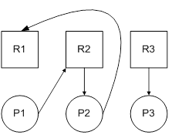
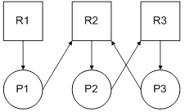
Sample question Deadlock detection and graph reduction
Figure: A
Figure: B
Fig A and Fig B show directed resource graphs for three processes (P1, P2 and P3 and three sources (R1, R2, R3). Using the detection/reduction algorithm Explain: For each of the above diagrams show: (14 marks)
If Is it deadlocked?
What is the result after reduction?
Which, if any processes are deadlocked

Slide 39
Sample question (bankers algorithm)
 | Allocation | Max | Need | Available
 |  |  |  | 3 2 2 1
 | A B C D | A B C D | A B C D | A B C D
P0 | 4 0 0 1 | 7 0 2 1
P1 | 1 1 0 0 | 1 6 5 0
P2 | 1 0 4 5 | 3 3 4 6
P3 | 0 4 2 1 | 1 5 6 2
P4 | 0 3 1 2 | 2 4 3 2
Using Bankers algorithm answer the following:
How many resources of type A, B, C and D are there?
What are the contents of the Need matrix?
Is the system in a safe state? Provide reasoning for your answer (show the sequence in which the processes would finish)
If a request from process P2 arrives for additional resources of {0, 2, 0, 0}, can the Bankers algorithm grant the request immediately? Provide reasoning for your answer. (14 Marks)

Slide 40
Sample Question
What is the relationship between deadlock and starvation. Give two reasons why starvation can occur and how it can be resolved. (4 marks)

